Slide 1
Surrogate Gradient Learning in Spiking Neural Networks
Emre O. Neftci, Hesham Mostafa, and Friedemann Zenk

Slide 2
Introduction
RNNs and biological NNs share several properties, such as a similar general architecture, temporal dynamics, and learning through weight adjustments.
Efficiently training large-scale RNNs is challenging due to a variety of extrinsic factors (noise and non-stationarity of the data), but also due to the inherent difficulties (optimizing functions with long-range temporal and spatial dependencies).
In SNNs and binary RNNs, these difficulties are compounded by the nondifferentiable dynamics implied by the binary nature of their outputs

Slide 3
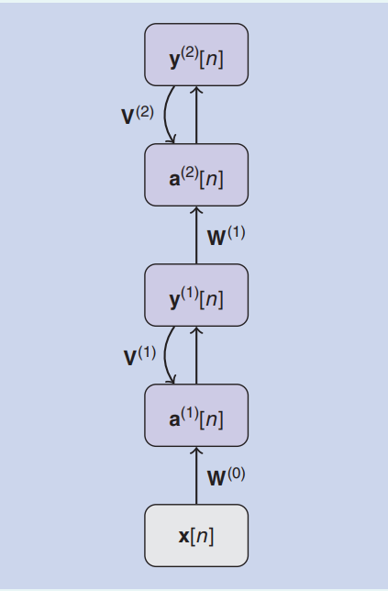
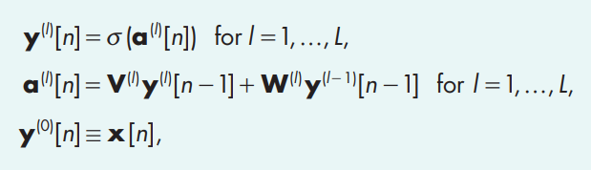
Recurrent neural network (S1)
The term RNNs refer to networks whose state evolves in time according to a set of recurrent dynamical equations. Such dynamical recurrence can be because of the explicit presence of recurrent synaptic connections between neurons in the network.

Slide 4
Recurrent neural network
Dynamical recurrence can also arise in the absence of recurrent connections.
This happens when stateful neuron or synapse models, which have internal dynamics, are used. Because the network’s state at a particular time step recurrently depends on its state in previous time steps, these dynamics are intrinsically recurrent. The term recurrently connected NN (RCNN) for the subset of networks that have explicit recurrent synaptic connections.

Slide 5

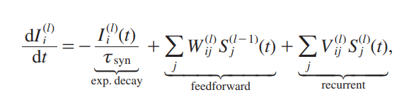
Leaky integrate and fire (lif)
The equation is for the dynamics during the absence of spikes.
the V^{(l)} _{ij} corresponds to explicit recurrent connections within each layer. Because of this property, we can simulate a single LIF neuron with two linear differential equations whose initial conditions change instantaneously whenever a spike occurs.

Slide 6
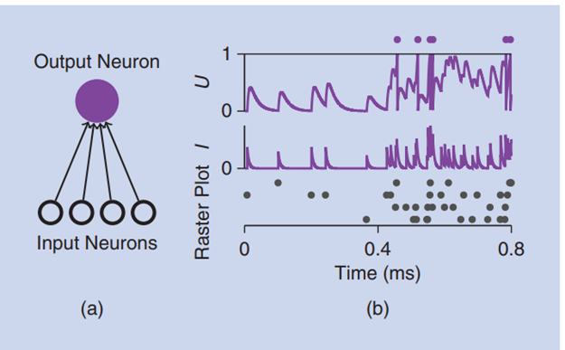



Leaky integrate and fire (lif)
Without loss of generality, we set U_{rest} = 0, R =1,
and threshold voltage =1.

Slide 7
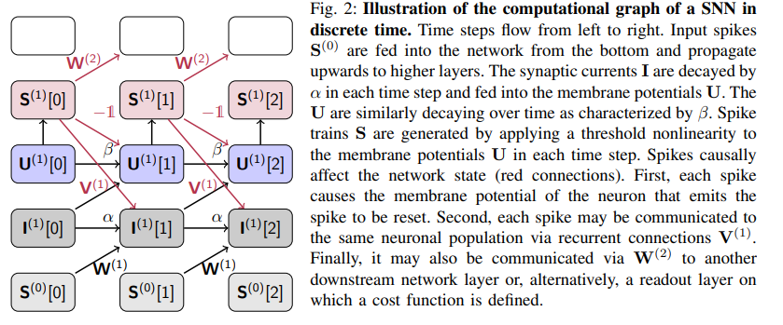

SNN as a case of RNN

Slide 8
Training rnns
Two ingredients to train a RNN
cost or loss function, which is minimized when the network’s response corresponds to the desired behavior.
a mechanism that updates the network’s weights to minimize the loss.
The simplest and most used form of updating weights is Gradient Descent on the loss function. Gradient-descent learning solves this credit assignment problem by providing explicit expressions for these updates through the chain rule of derivatives.

Slide 9
Training rnns
The 2 credit problems are spatial (in MLPs and RNNs) and temporal (only in RNNs).
Spatial credit assignment: Backpropagation (BP)-of-error algorithm. Using BP to adjust hidden-layer weights ensures that the weight update will reduce the cost function for the current training example, provided the learning rate is small enough.
Cost of using BP:- gradients must be propagated back through the network, and increased memory requirements as the neuron states must be kept in memory until the errors become available.

Slide 10


The Gradient Backpropagation Rule for Neural Networks (S2)
Learning is typically carried out in forward passes (evaluation of the NN activities) and backward passes (evaluation of δs).

Slide 11
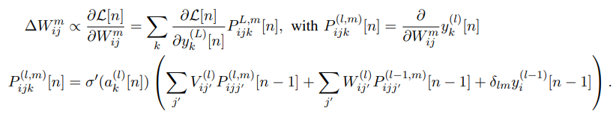
Training rnns
Temporal credit assignment:
Backward method: Back propagation through time (BPTT). This method works backward through time after completing a forward pass.
Forward method: In some situations, it is beneficial to propagate all necessary information for gradient computation forward in time

Slide 12
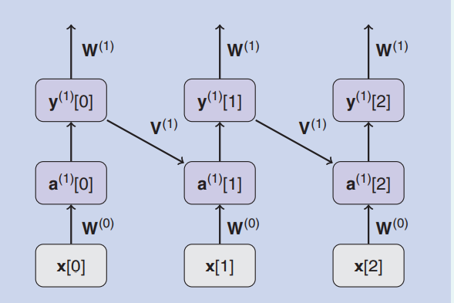
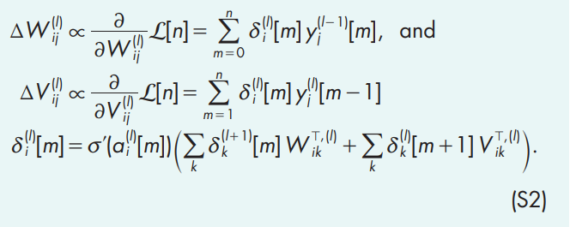
The Gradient Backpropagation Rule for Neural Networks (S2) - BPTT
The same rule can be applied to recurrent NNs. In this case, the recurrence is “unrolled,” meaning that an auxiliary network is created by making copies of the network for each time step.

Slide 13
Training rnns
BPTT has a space complexity of O(NT), whereas forward method has O(N³) due to variable P which can be simplified to O(N²) or even O(N).
From a biological perspective, the forward method is more appealing. The learning rule can be made consistent with synaptic plasticity in the brain and “three-factor” rules.

Slide 14
Training SNNs
Challenges faced while applying the same training methods to SNNs.
Non-differentiability of the spiking nonlinearity.
Standard BP can be expensive in terms of computation, memory, and communication and may be poorly suited to the constraints dictated by the hardware that implements it. The forward method is better in this case, but scaling it to larger networks causes it to be bound by the processing units memory.

Slide 15
Training SNNs
The most common approaches to rectify 1 are:
resorting to entirely biologically inspired local learning rules for the hidden units;*
translating conventionally trained “rate-based” NNs to SNNs;*
smoothing the network model to be continuously differentiable;
defining an SG as a continuous relaxation of the real gradients.
* : not discussed in this paper

Slide 16
Smoothing the Network model
Smooth models can be further categorized into
soft nonlinearity models;
probabilistic models, for which gradients are well defined only in expectation,
or models that rely entirely on rate; or
Models that rely on single-spike temporal codes.

Slide 17
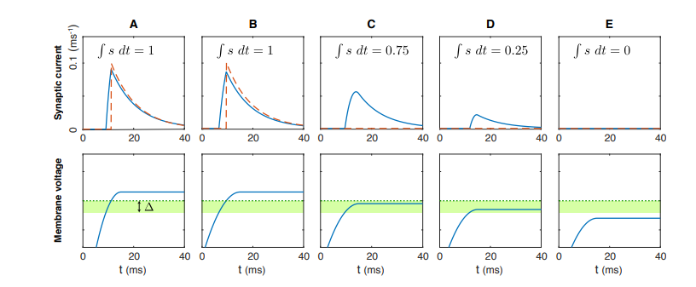
(1) Soft non-linearity models
(Huh and Sejnowski) Replace the delta function with g, a gate function with narrow support called the active zone. This allows the synaptic current to be activated in a gradual manner throughout the active zone. The soft threshold models compromise on one of the key features of SNNs, i.e., the binary spike propagation.

Slide 18








(2) probabilistic models
Stochasticity effectively smooths out discontinuous binary nonlinearity, which makes it possible to define a gradient on expectation values.
[Estimating or Propagating Gradients Through Stochastic Neurons for Conditional Computation, Bengio].

Slide 19
(3) Rate coding networks
The main idea is that spike rate is the underlying information-carrying quantity. For many plausible neuron models, the suprathreshold firing rate depends smoothly on the neuron input.
This input-output dependence is captured by the f-I curve of a neuron. In such cases, the derivative of the f-I curves is suitable for gradient-based optimization.

Slide 20
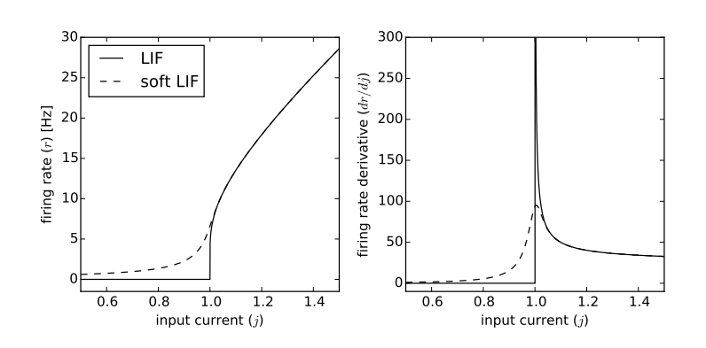





(3) Rate coding networks
[Spiking Deep Networks with LIF Neurons]
LIF:
Soft LIF with noise:

Slide 21
(3) Rate coding networks
The distinction between rate coding and probabilistic networks can be blurry because many probabilistic network implementations use rate coding at the output level.
Probabilistic models are based on a firing probability densities. Importantly, the firing probability of a neuron is a continuous function.
In contrast, deterministic networks always emit a fixed-integer number of spikes for a given input.

Slide 22
(4) single-spike timing-coding networks
In such a temporal coding setting, individual spikes could carry significantly more information than rate-based schemes that consider only the total number of spikes in an interval.
[Error-backpropagation in temporally encoded networks of spiking neuron] The approximation only holds when the weights to a neuron are not altered such that the membrane potential no longer reaches threshold, and the neuron hence no longer fires. It is a potential problem, but can be countered by encoding input into the network in such a way that early spikes are automatically “more important” than later spikes.

Slide 23

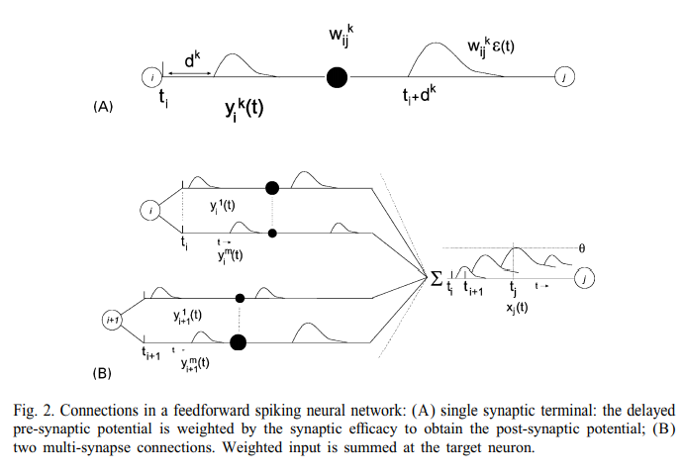

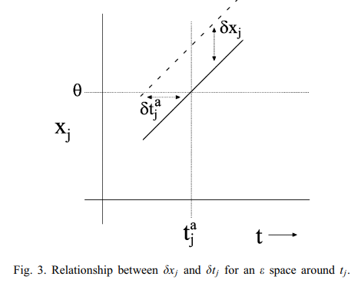
(4) single-spike timing-coding networks

Slide 24

(4) single-spike timing-coding networks
Although the spike-timing formulation does, in some cases, yield well-defined gradients, it may suffer from certain limitations. For instance, the formulation of SpikeProp required each hidden unit to emit exactly one spike per trial because it is impossible to define firing time for quiescent units.

Slide 25
Surrogate gradients
Instead of changing the model definition as in the smoothed approaches, an SG is introduced.
Consider SGs, which constitute a continuous relaxation of the non-smooth spiking nonlinearity for purposes of numerical optimization.
Also consider SGs with more profound changes that explicitly affect locality of the underlying optimization algorithms themselves to improve the computational and/or memory access overhead of the learning process.

Slide 26
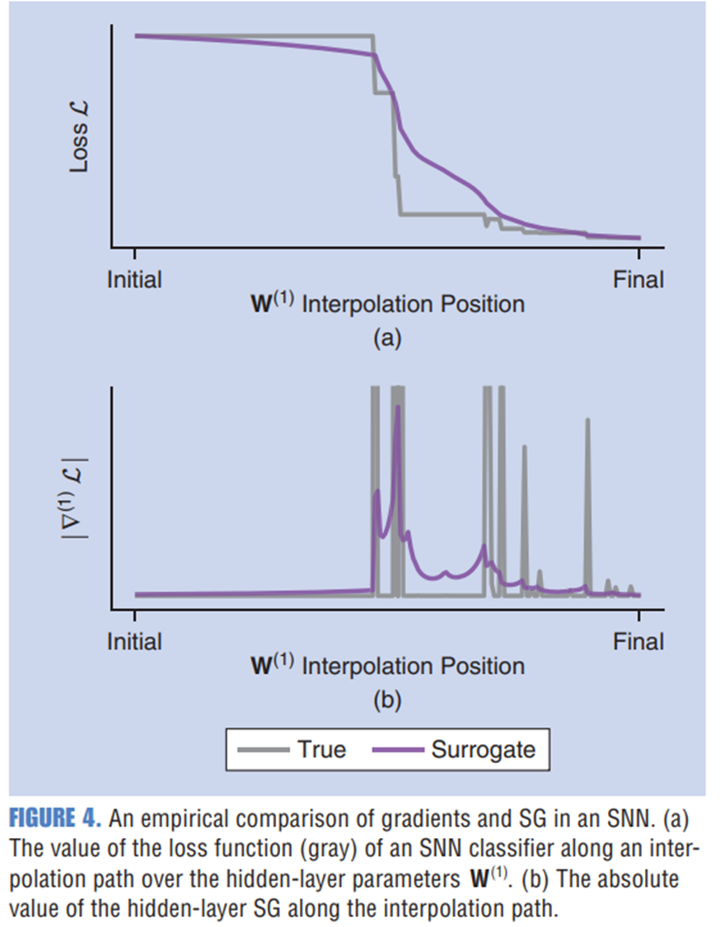
Surrogate gradient
Linear interpolation between the random initial and final (post-optimization) weight matrices of the hidden-layer inputs W^{(1).}
Note that the “true gradient” is calculated via the finite differences method. Importantly, the SG approximates the true gradient but retains favorable properties for optimization, i.e., continuity and finiteness. The SG can be thought of as the gradient of a virtual surrogate loss function [the violet curve in (a) obtained by numerical integration of the SG and scaled to match loss at the initial and final points].

Slide 27
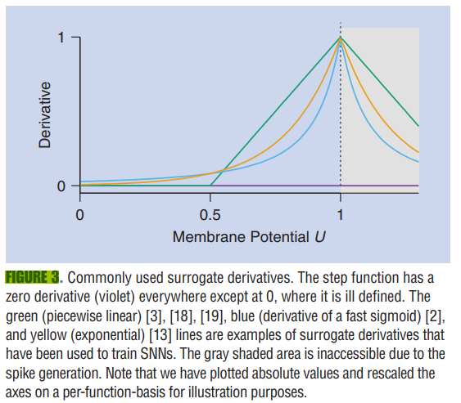
Surrogate derivatives for the spiking nonlinearity
Within the algorithm, each occurrence of the spiking nonlinearity derivative is replaced by the derivative of a continuously differentiable function.
These non-linearities, have a common underlying theme: All functions are nonlinear and monotonically increase toward the firing threshold.

Slide 28
Applications
A selection of applications of smooth or SGs to SNNs, which exploit both the internal continuous-time dynamics of the neurons and their event driven nature:
Feedback alignment and random error BP
Supervised learning with local three-factor learning rules
Learning using local errors
Learning using gradients of spike times

Slide 29
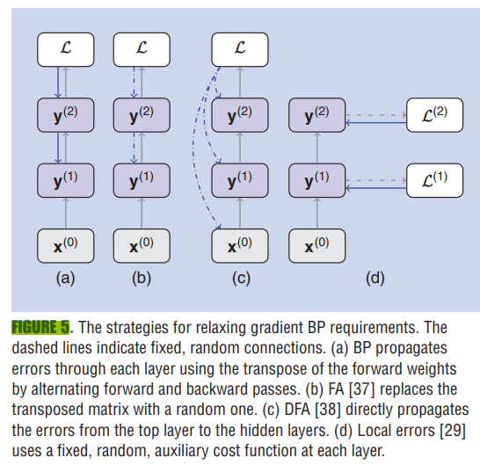

Slide 30
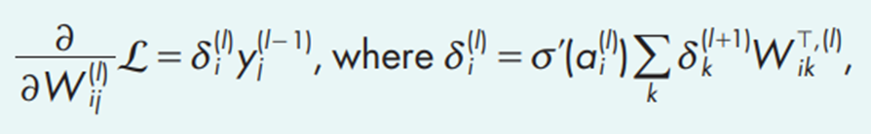

(1) Feedback alignment and random error BP
These are approximations to the gradient BP rule that sidestep the nonlocality problem by replacing weights in the BP rule with random ones.
Where G is the fixed, random weight matrix that breaks the dependency on W.
Simulation studies have shown that, during learning, the network adjusts its feedforward weights such that they partially align with the (random) feedback weights, thus permitting them to convey useful error information

Slide 31
(1) Feedback alignment and random error BP
To obtain the SGs, the approximation of the derivative of the neural activation function using a symmetric function that is zero everywhere except in the vicinity of zero, where it is constant, is made. The derivative of this function exists and is piecewise constant.
Limitation with random BP applied to SNNs was that the temporal dynamics of the neurons and synapses was not taken into account in the gradients.

Slide 32


(2) Supervised learning with local three-factor learning rule
This learning rule is better for hardware implementations because it is an online rule that does not require backpropagating error information through time.
The SuperSpike learning rule is a forward-in-time optimization procedure that was derived for temporal supervised learning tasks in which a given output neuron learns to spike at predefined times. (simple 2 layer network)
SuperSpike relies on a form of random BP to propagate error signals directly from the output layer to the hidden units.
ϵ is a simple temporal convolutional kernel

Slide 33
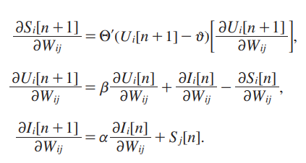


(2) Supervised learning with local three-factor learning rule
S_{k} is the final output spike train.
Heaviside function is replaced with σ‘(U[n] − ϑ).
The reset term in second equation is dropped.
For multiple hidden layers, error updating would become non-local. For networks with additional hidden layers, the output errors are simply broadcast through either random or structured weights A.
Target spike train in referred paper was chosen to be 5 equidistant spike in a period of 500ms.

Slide 34
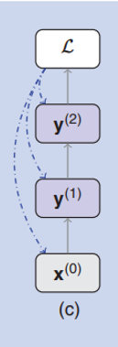

(2) Supervised learning with local three-factor learning rule
For networks with additional hidden layers, the output errors are simply broadcast through either random or structured weights A:
SuperSpike achieves temporal credit assignment by propagating all relevant quantities forward in time through eligibility traces defined by the neuronal dynamics [(9) and (10)], while it relies on random BP to perform spatial credit assignment.

Slide 35

(3) Learning using local errors
The scalability of SuperSpike can be improved by introducing local errors.
Multilayer NNs are hierarchical feature extractors. Through successive linear projections and pointwise nonlinearities, neurons become tuned (i.e., respond most strongly) to particular spatiotemporal features in the input.
The nonlocal component of the weight update, is the error term .Rather than obtaining this error term through BP, it can be generated using information local to the layer. One way of achieving this is to define a layer-wise loss and use this local loss to obtain the errors.

Slide 36

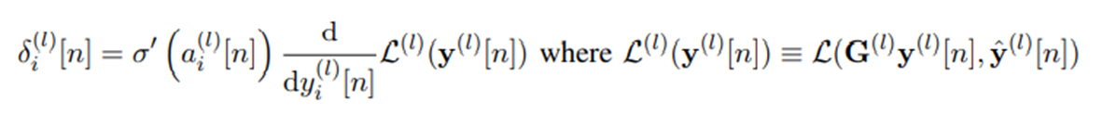
(3) Learning using local errors
yˆ^{(l)} [n] a pseudo-target for layer l, and G^{(l)} a fixed random matrix that projects the activity vector at layer l. This formulation assumes that an auxiliary random layer is attached to layer l, with the goal of modifying W^{(l)} so as to minimize the discrepancy between the auxiliary random layer’s output and the pseudo-target (use top-layer target).

Slide 37
(3) Learning using local errors
Each layer builds on the features learned by the layer below it, and we empirically observe that higher layers are able to learn higher-quality features that allow their random and fixed auxiliary layers to better match the target.
This forces each layer to learn a set of features that can match the top-layer target after undergoing a fixed random linear projection.
For SNNs, a combination of Local Errors and SuperSpike forward method is used.
This simplification results in a forward method whose space complexity scales as O(N) .

Slide 38
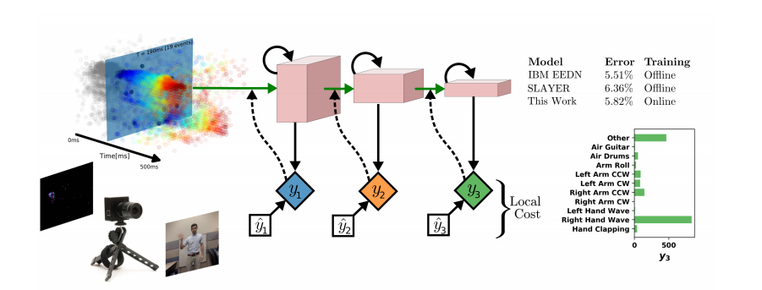
(3) Learning using local errors
SLAYER: Spike Layer Error Reassignment
EEDN: Energy-Efficient deep neuromorphic networks (convolution networks)

Slide 39

(4) Learning using gradients of spike times
Spike times are continuous quantities that can be made to depend smoothly on the neuron’s input. In a non-leaky neuron
where t^{r}_{j} is the time of the r^{th} spike from neuron j and ϴ is the Heaviside step function.
A first-to-spike code is used, which has two output neurons, and the binary classification result is represented by the output neuron that spikes first, is used.

Slide 40
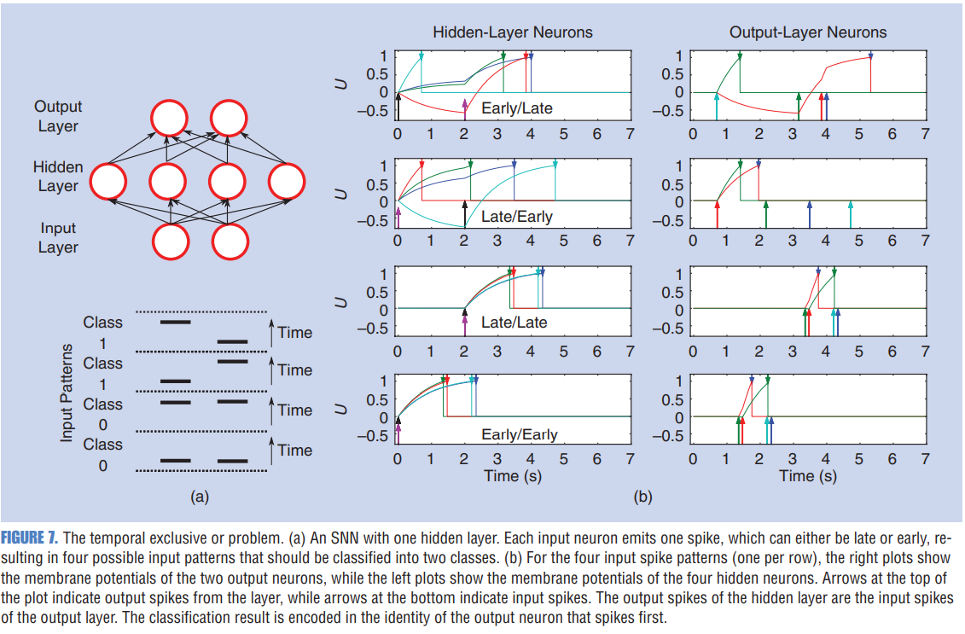

Slide 41
Conclusions
Focus on SG approaches for two reasons: SG approaches are able to train SNNs to perform at unprecedented performance levels on a range of real-world problems.
For the neuromorphic community, SG methods provide a way to learn under various constraints on communication and storage, which makes SG methods highly relevant for learning on customized, low-power neuromorphic devices

